Slide 1
Data Lake Analytics

Slide 2

Overview
In today's data-driven world, the ability to efficiently process and analyze large volumes of data is crucial for businesses to gain insights and make informed decisions. This project aims to leverage the power of Azure Databricks and PySpark to perform data analytical tasks, including Extract, Transform, and Load (ETL) operations, on massive datasets.

Slide 3
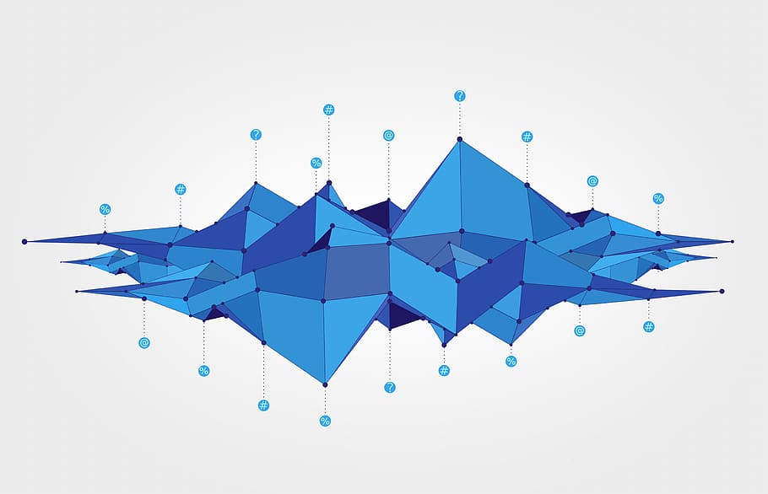
About Project
This project revolves around the seamless orchestration of data movement, transformation, and analytics by integrating Azure Data Factory (ADF) and Azure Databricks. The workflow involves moving data from Azure Blob Storage to Azure Data Lake Storage Gen2 (ADLS Gen2) using ADF, mounting the ADLS Gen2 within Databricks notebooks for data transformations and analytics, and finally, persisting the analytical results back to ADLS Gen2.

Slide 4
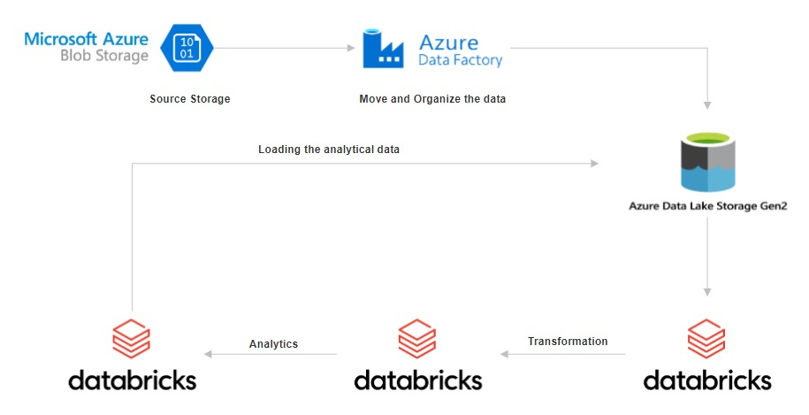
Architectural Diagram

Slide 5
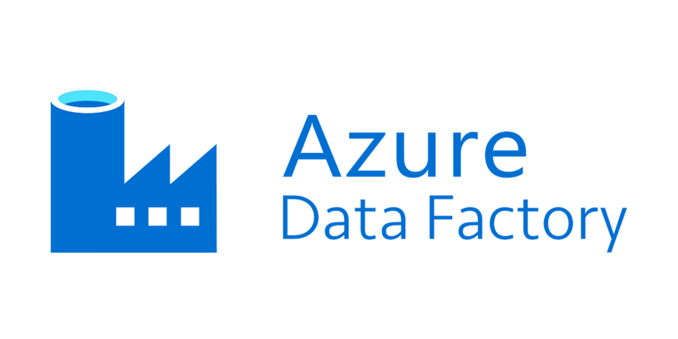
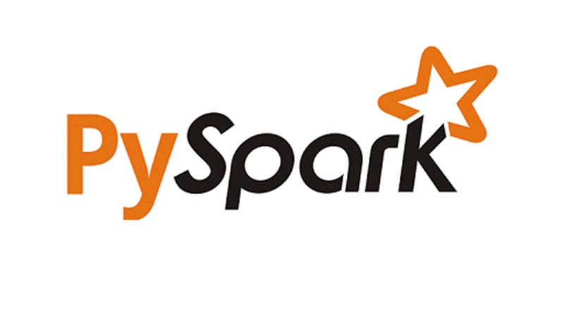
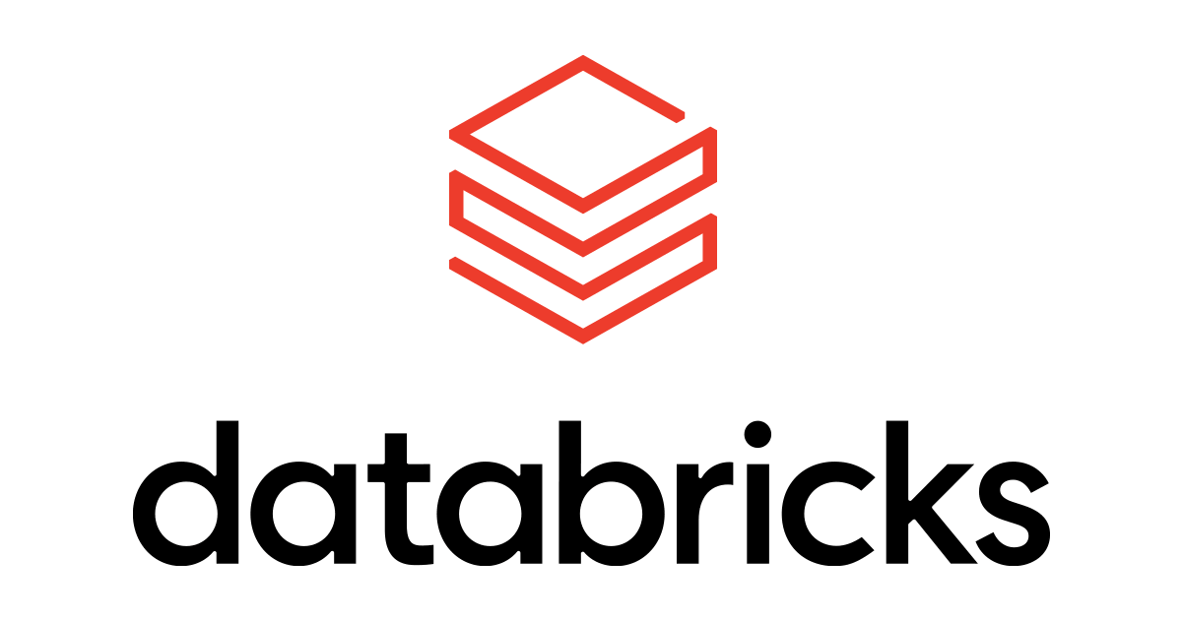
Requirements of the project

Slide 6
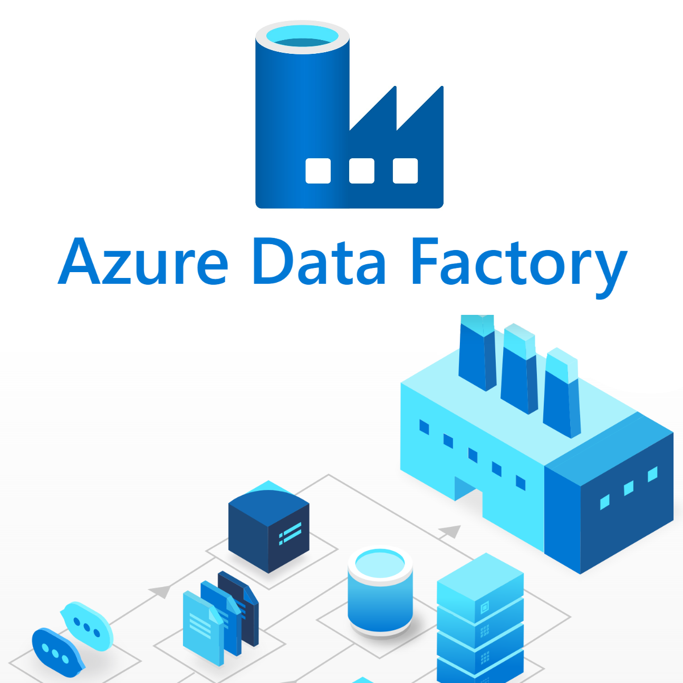
Azure Data Factory
Azure Data Factory(ADF) allows users to create, schedule, and manage data pipelines that can move data between various supported data stores. ADF provides a scalable, fully managed platform for orchestrating and automating data workflows.
It has many features such as data orchestration, seamless integration with Azure services, hybrid data integration, security, scalability, monitoring, metadata management, and cost management, enabling users to create, automate, and manage data pipelines for diverse data workflows.

Slide 7

Azure Data Bricks
Azure Databricks provides a cloud-based platform for big data analytics and machine learning. It offers a collaborative environment for data engineers, data scientists, and analysts to work together seamlessly.
Databricks provides managed Spark clusters, eliminating the need for infrastructure management and allowing teams to focus on data processing tasks.

Slide 8
PySpark
PySpark is the Python API for Apache Spark, a powerful open-source framework for distributed data processing. PySpark simplifies development tasks by providing a Python interface to Spark's capabilities.
With PySpark, developers can write concise and expressive code to perform complex data transformations, aggregations, and analytics on large datasets.

Slide 9

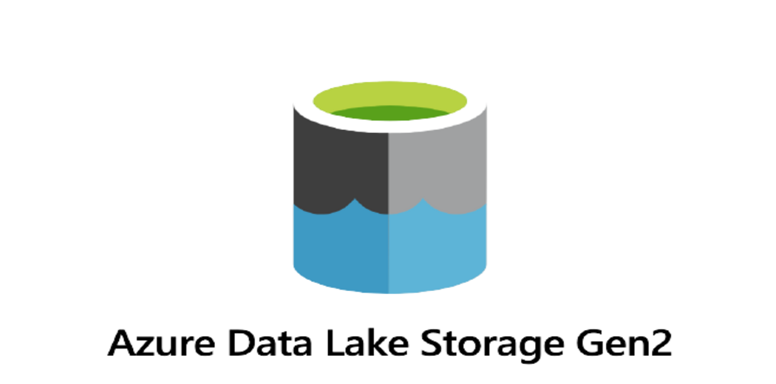
Resources used for this project

Slide 10
Work Flow

Slide 11
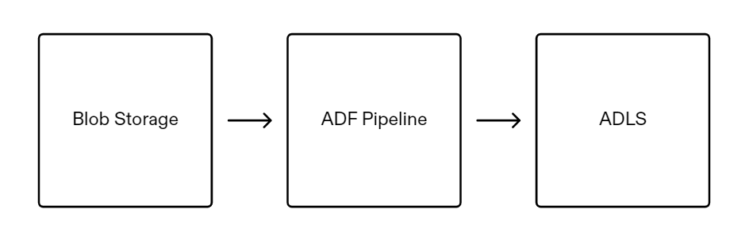
Step 1 : Move the data from Blob storage to ADLS Gen 2 using ADF

Slide 12
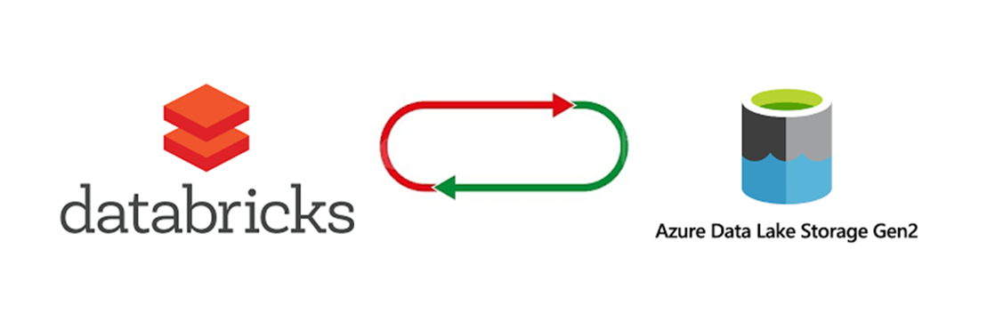
Step 2 : Extracting the data from ADLS to Data bricks

Slide 13
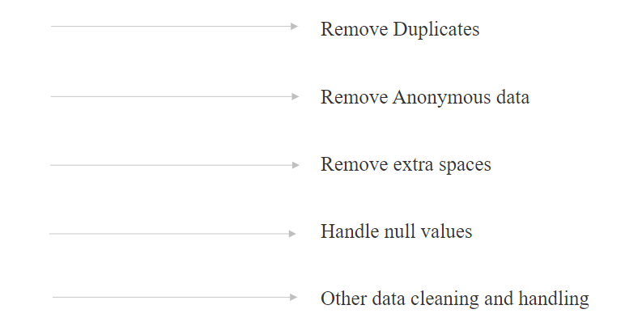
Step 3 : Performing transformations on the data

Slide 14
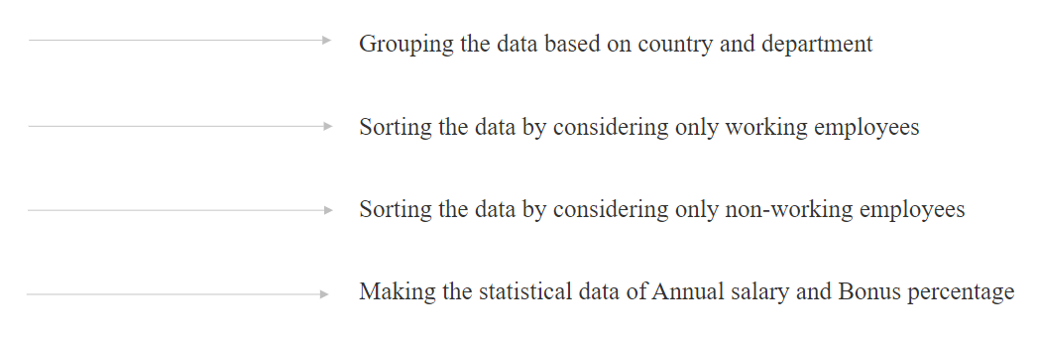
Step 4 : Perform Analytics on the data

Slide 15
Step 5 : Store the output files in ADLS

Slide 16
Output Screenshots

Slide 17
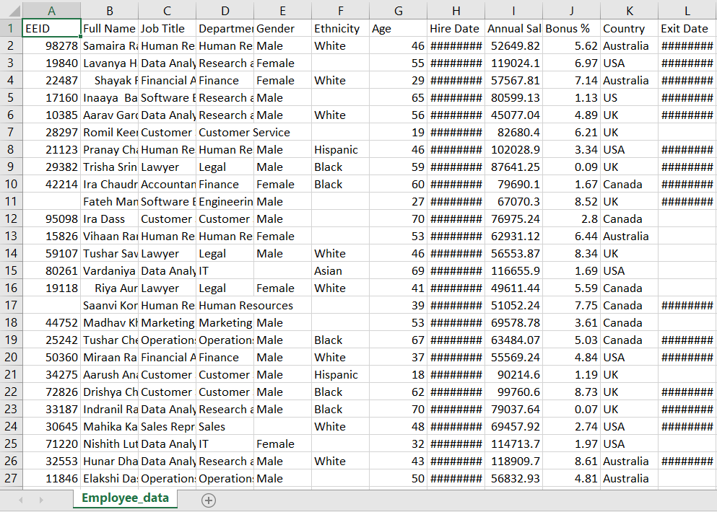
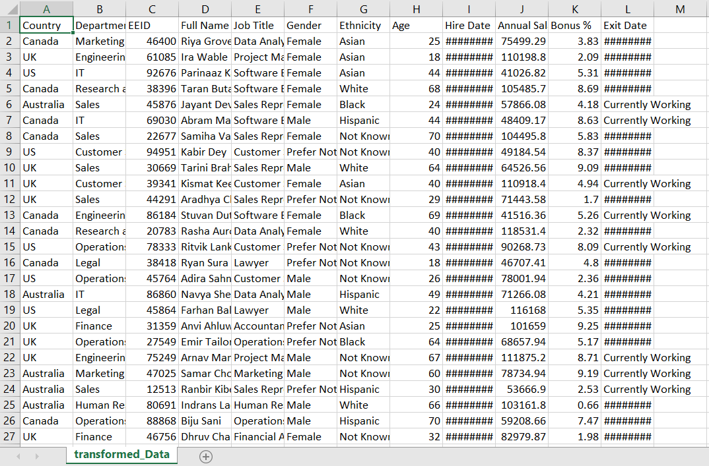
Raw Data
Transformed Data

Slide 18
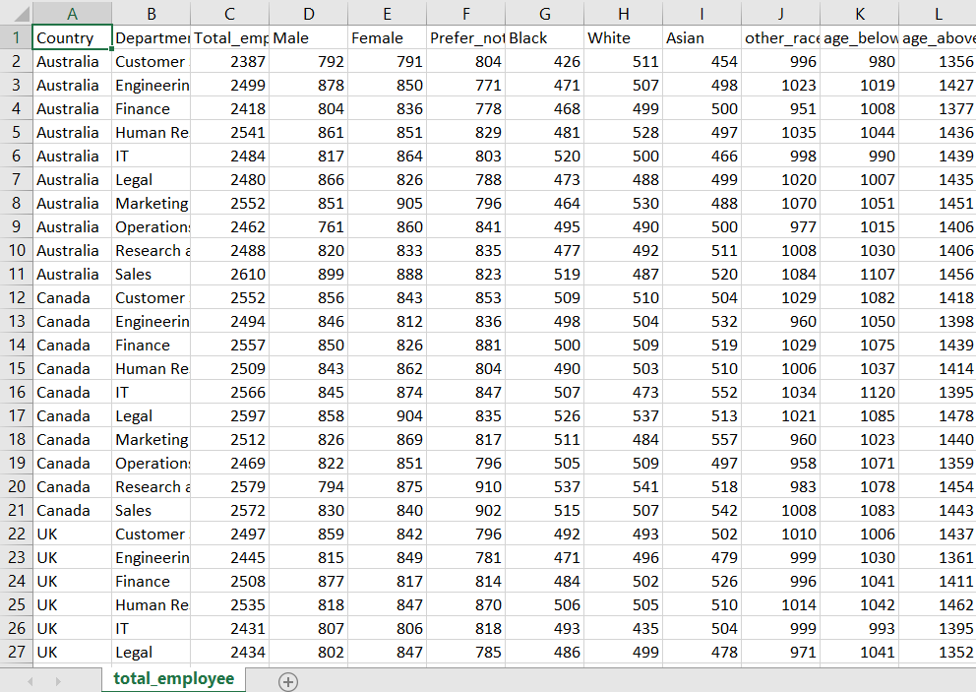
Grouped Data

Slide 19
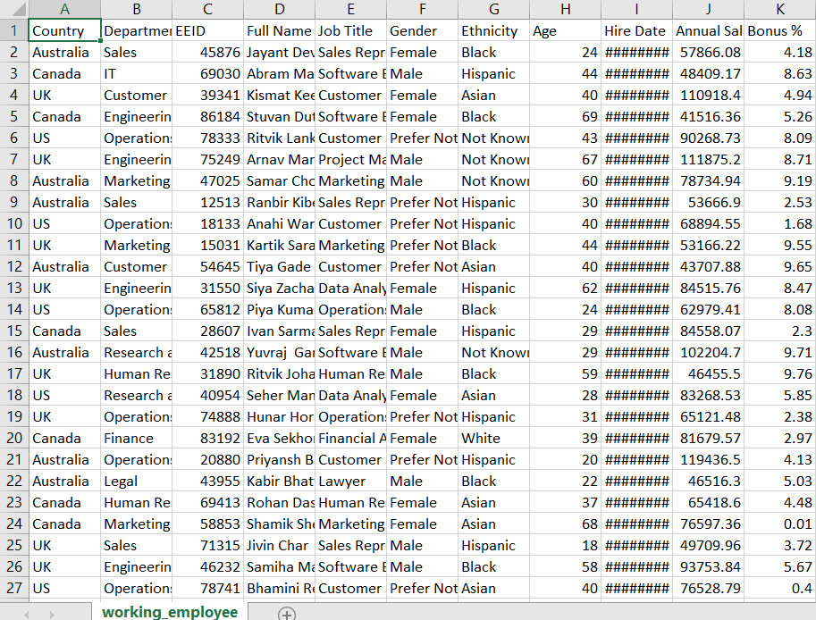
Working Employee Data

Slide 20
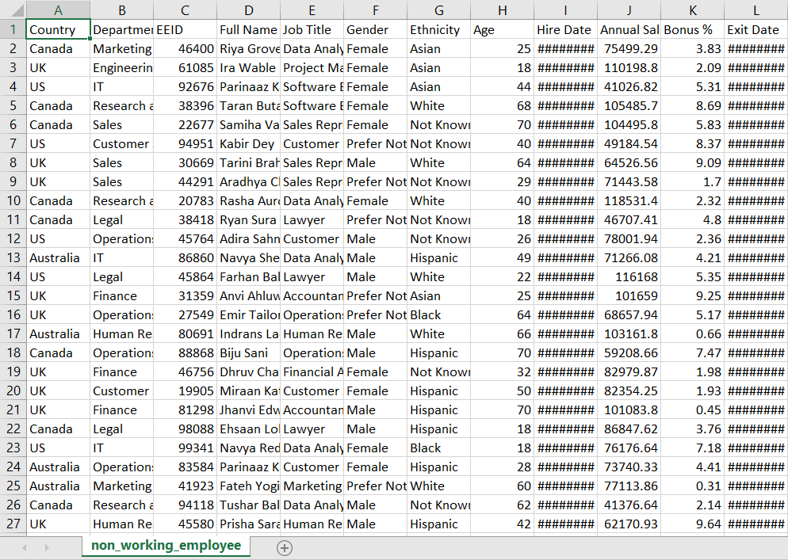
Non – working employee data

Slide 21
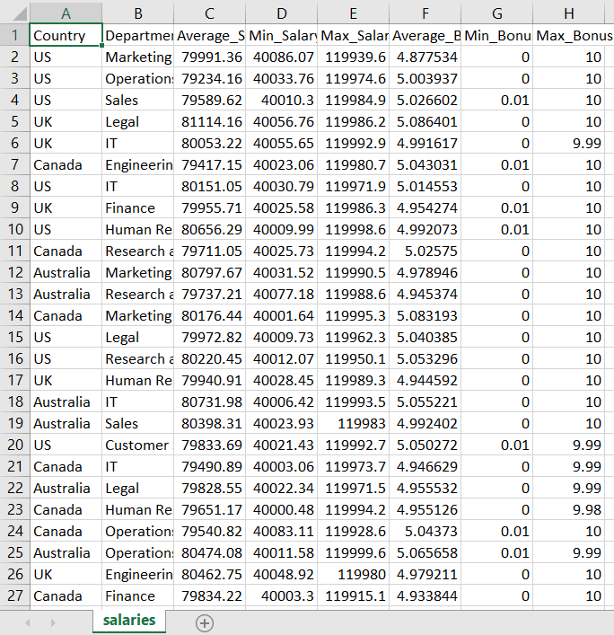
Salaries and Bonus Data

Slide 22
Data Visualization

Slide 23
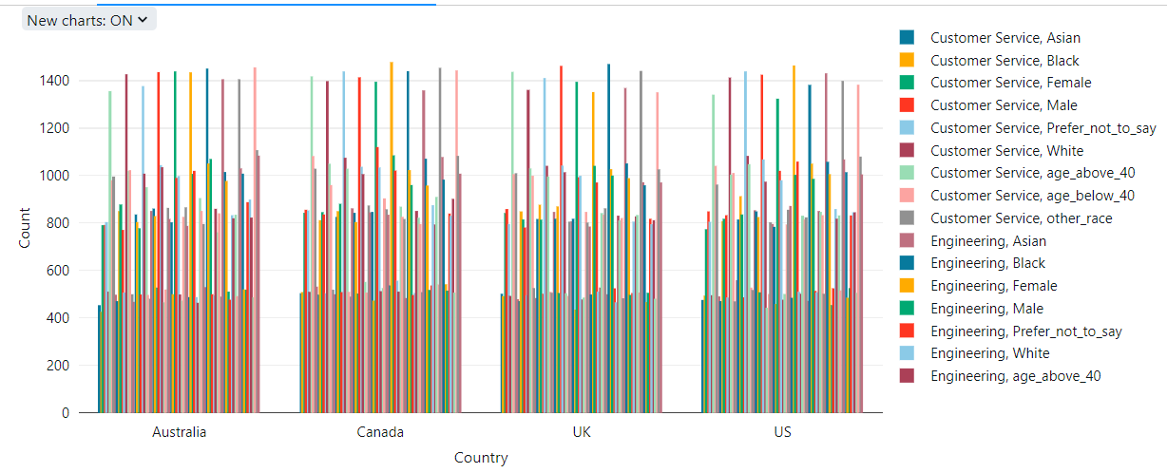
Grouped data Visualization
Bar graph visualization

Slide 24
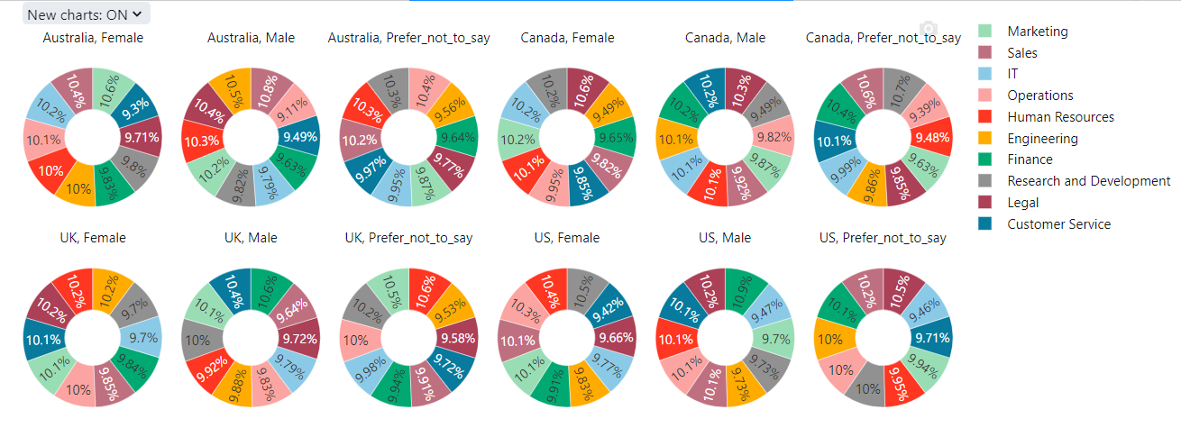
Pie chart of Departmental Statistical data based on gender

Slide 25
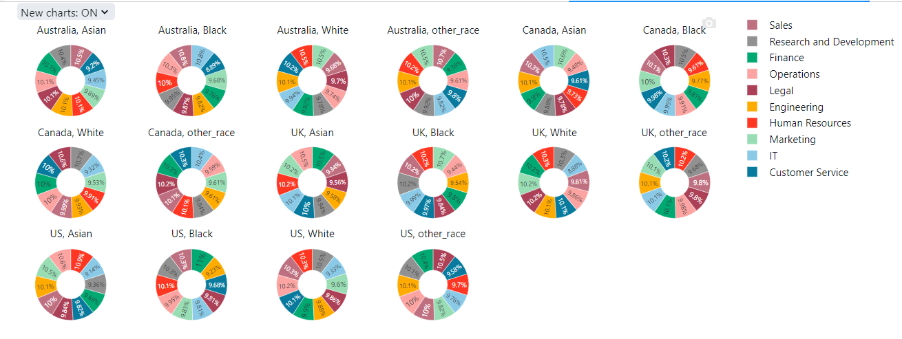
Pie chart of Departmental Statistical data based on ethnicity

Slide 26
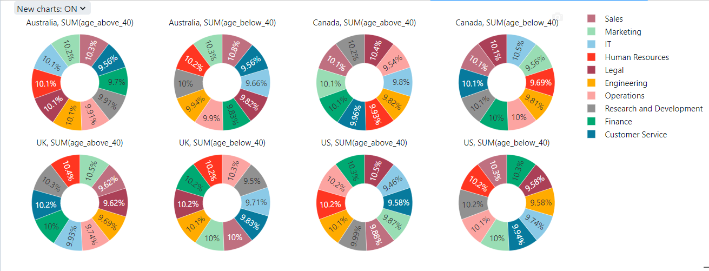
Pie chart of Departmental Statistical data based on age

Slide 27
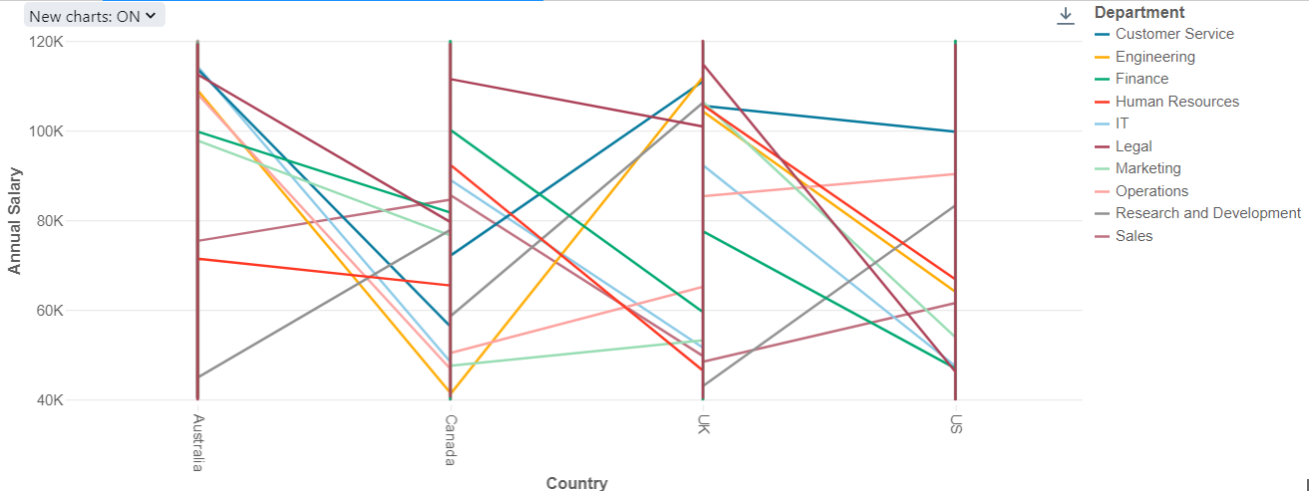
Working Employe Data Visualization
Departmental wise Annual Salary for each country

Slide 28
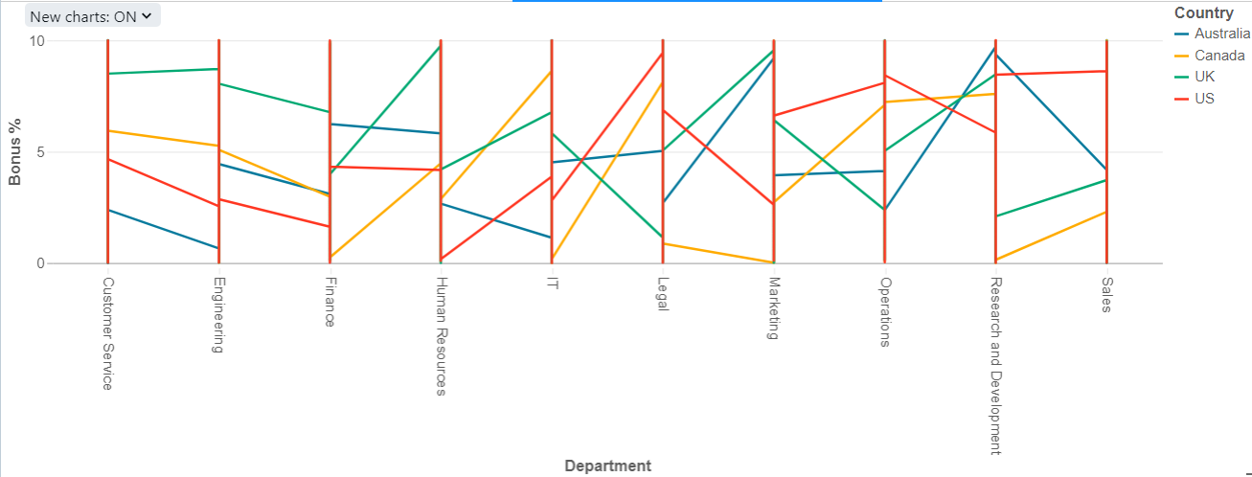
Departmental wise Bonus percentage for each country

Slide 29
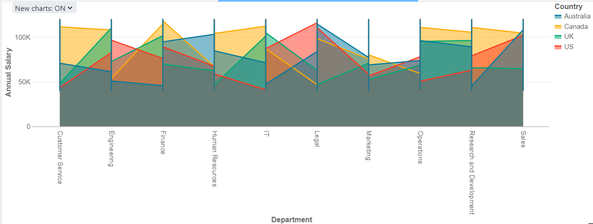
Non - working Employe Data Visualization
Departmental wise Annual Salary for each country

Slide 30
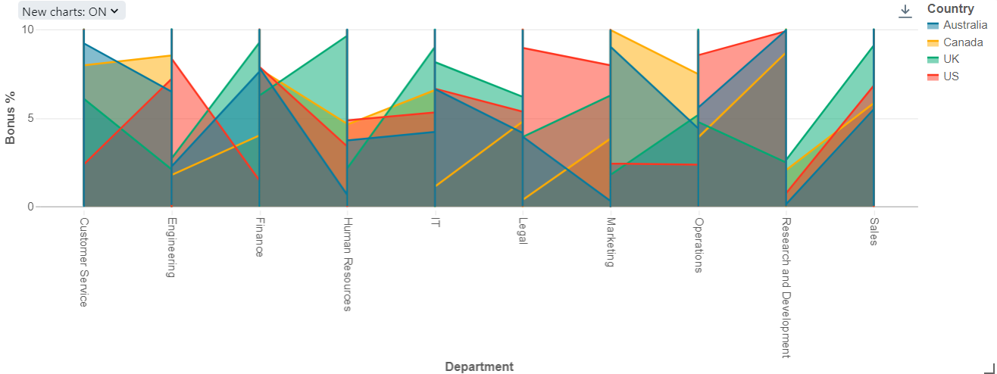
Departmental wise Bonus percentage for each country

Slide 31
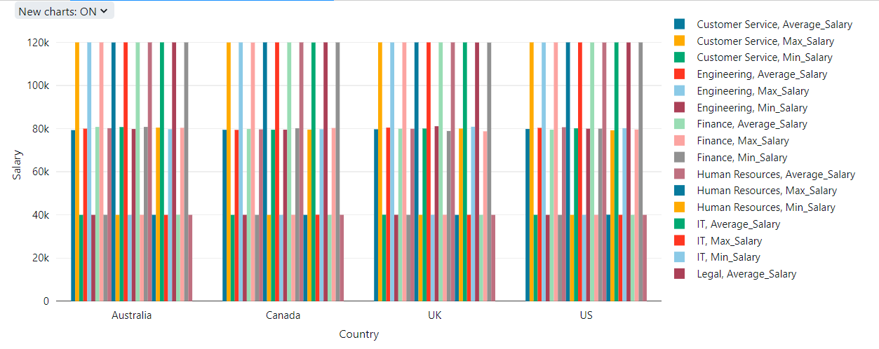
Salaries and Bonus Data Visualization
Department wise Annual Salary for each country

Slide 32
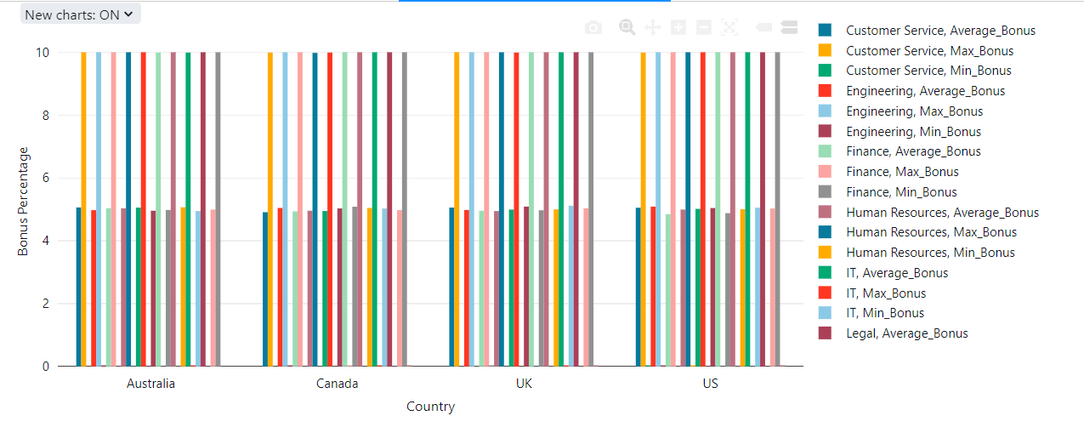
Department wise Bonus percentage for each country

Slide 33
Conclusion
In conclusion, this project showcases a cohesive data processing pipeline leveraging Azure Data Factory and Azure Databricks, seamlessly moving data from Azure Blob Storage to Azure Data Lake Storage Gen2 then processing the data by performing transformation and analytical operations through azure databricks, then loading and organizing the data back to Azure data lake storage.

Slide 34
Thank You

